Slide 1
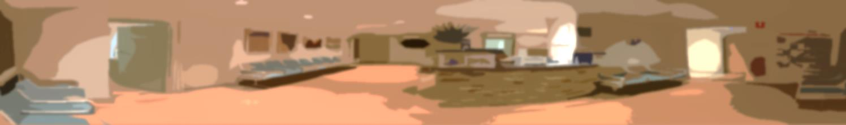
Patient Centred
Medical Home
- The Building Blocks of High Performing Primary Care -
Mt Druitt Medical Centre
www.mtdruittmedicalcentre.com.au
15 November 2016
Dr Kean-Seng Lim
MBBS (Syd), FRACGP, GAICD
keansenglim@hotmail.com
Dea Krismarietta
Accredited Practicing Dietitian
d.krismarietta@gmail.com

Slide 2
1. Introduction
Who are we ?
What we decided to do ?

Slide 3
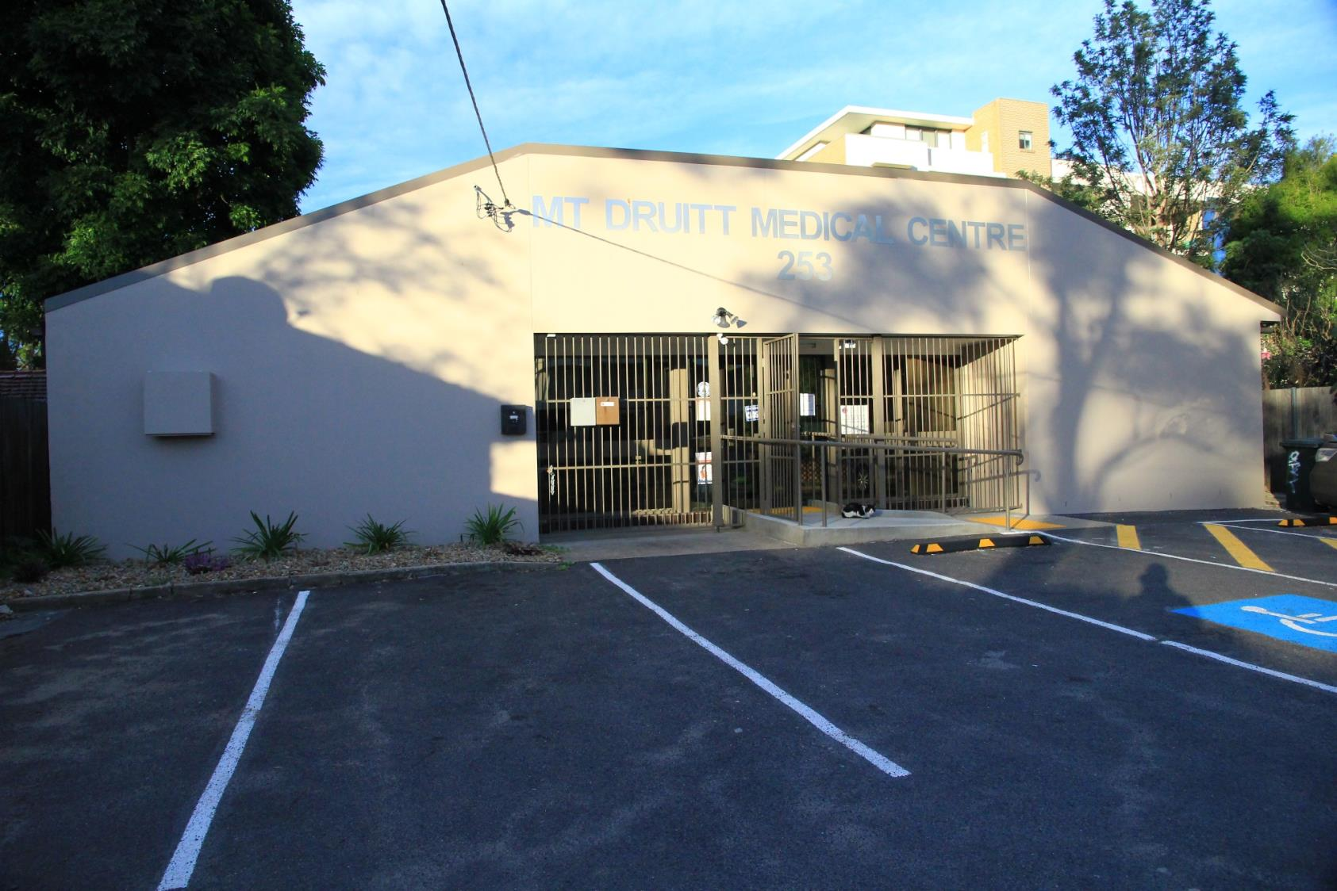
Notes:
This is our practice

Slide 4
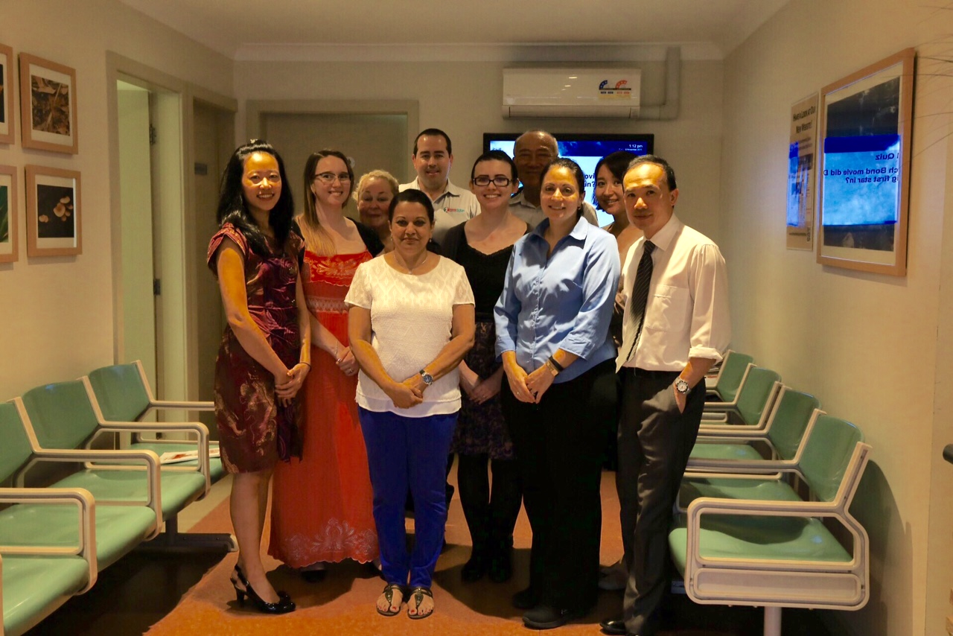
Notes:
This is our team.

Slide 5
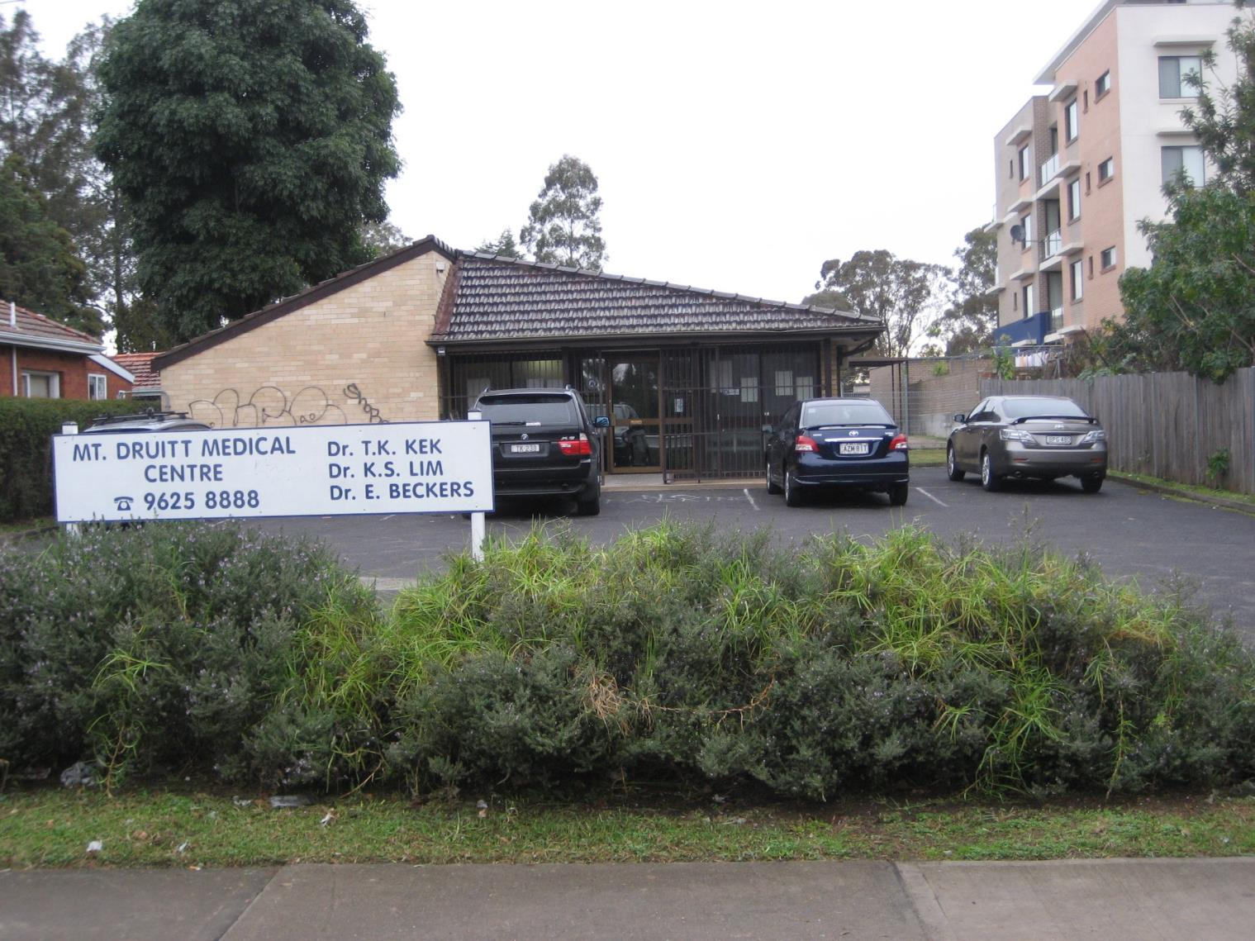
Notes:
A few years ago, we were a small 3 doctor practice.
We had to decide where we were going to go.

Slide 6
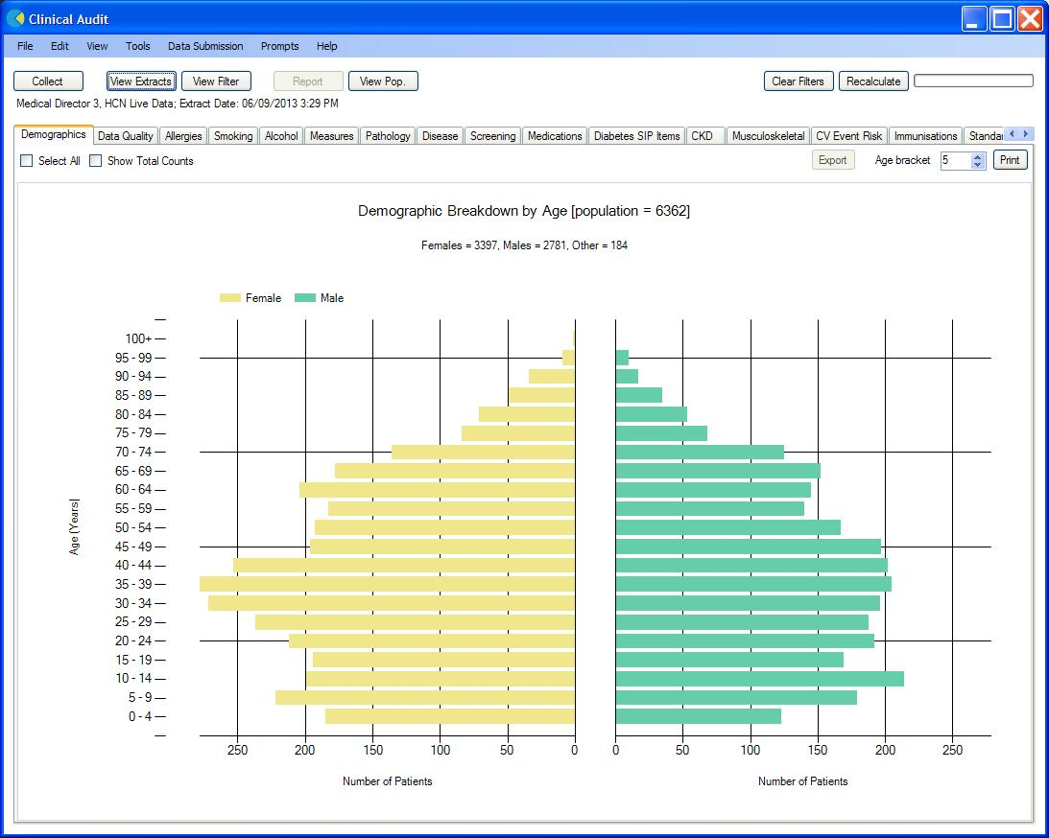
Notes:
A practice can also be defined by its patients.
This is our practice
Not quite sure why we have fewer male children and infants.

Slide 7
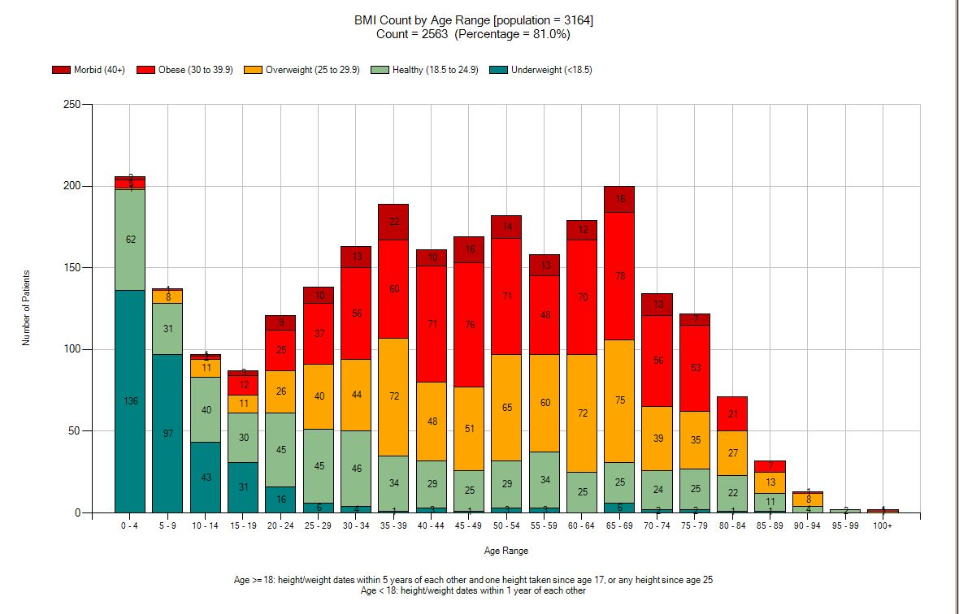
Notes:
This is another view of our practice – BMI
Scary picture, with increasing rates Way above the national average after 35 years of age.
Funny how weight just starts to go up after 35.
This is what we work with.

Slide 8
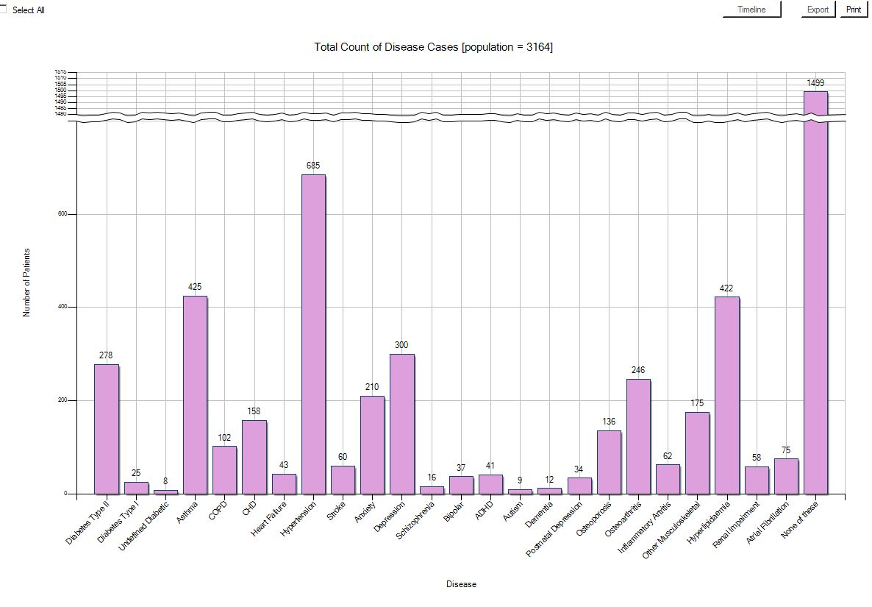
Notes:
This is our practice population
- By disease/condition
Lots of diabetes, asthma, hypertension, but also psychiatric disorders.

Slide 9
Notes:
More than half of our patients have a chronic health condition, with almost a quarter having 2 or more conditions

Slide 10
Notes:
Diabetes is above the national average, with large numbers of prediabetics as well. This number may well be underestimated

Slide 11
Who are we?
What do we stand for?
Where to from here?
Notes:
The practice came to a crossroad – the existential question - where to from here?

Slide 12

Notes:
All we knew was we wanted to be better.
But what did that mean?

Slide 13
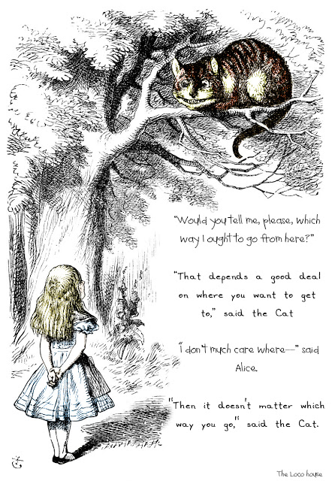
Notes:
This is the dilemma, but it is also the start of something,
The first thing is acknowledging the need to change

Slide 14
2. What is the PCMH ?
What is General Practice?
What is the PCMH?

Slide 15
RACGP Definition of General Practice
General practice provides person centred, continuing, comprehensive and coordinated wholeperson health care to individuals and families in their communities. As a sector, general practice, its practice teams and their primary health care relationships comprise the foundations of an effective health care system.

Slide 16
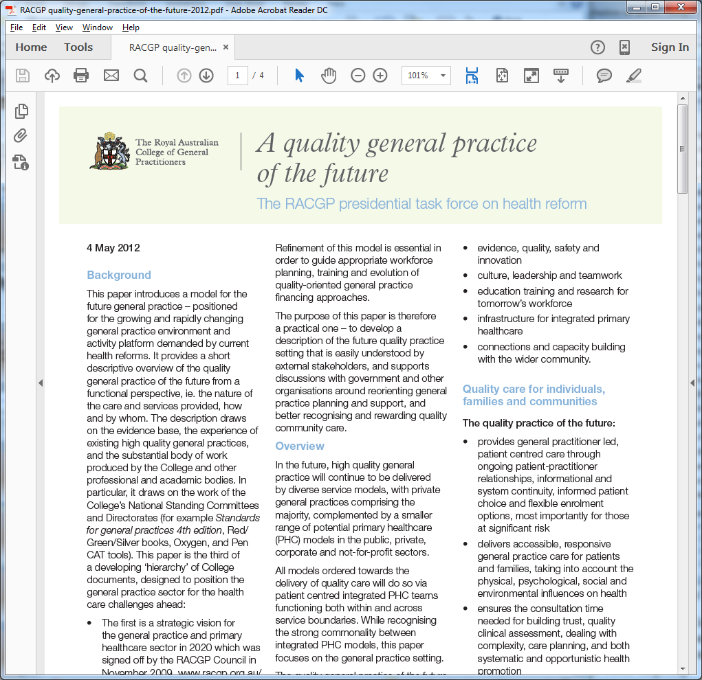
Notes:
So – how do we get there.
There has actually been a lot of work in this field
The 2012 RACGP Paper presents quite a good vision statement

Slide 17
American College of Physicians
The Patient-Centered Medical Home (PCMH) is a care delivery model whereby patient treatment is coordinated through their primary care physician to ensure they receive the necessary care when and where they need it, in a manner they can understand.
The objective is to have a centralized setting that facilitates partnerships between individual patients, and their personal physicians, and when appropriate, the patient’s family. Care is facilitated by registries, information technology, health information exchange and other means to assure that patients get the indicated care when and where they need and want it in a culturally and linguistically appropriate manner.

Slide 18

​​​​​​​​​​​​A medical home is not a building or a place.
It is an approach to providing comprehensive primary care that facilitates partnerships between patients, clinicians, medical staff, and families.

Slide 19
It is a place where a patient can form an ongoing relationship with a practice team,
Who provide co-ordinated, comprehensive, multidisciplinary, integrated team based care
Supported by a culture of data driven continuous quality improvement
Dr Vivienne Sharma, Mt Druitt Medical Centre 2016

Slide 20
3. Goals of Primary Care
Quadruple Aim
Core Principles of the PCMH
The Building Blocks of the PCMH

Slide 21
Quadruple Aim
Improving patient experience
Improving population health
Efficient cost
Improved Provider Satisfaction
Notes:
We didn't know what we wanted at the time – but THIS WAS IT – But how do we do it?

Slide 22
The Six Core Attributes of the PCMH
Comprehensive
Continuous
Accessible
Patient Centred
Co-Ordinated
Accountable

Slide 23
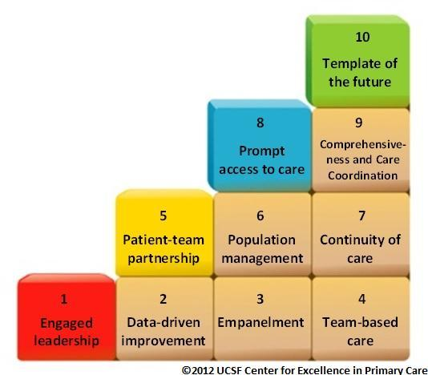
The 10 Building Blocks of High Performing Primary Care
Bodenheimer et al, Annals of Family Medicine Vol 12, No 2; Mar-Apr 2014
Notes:
One of the papers referenced in the position paper, and one of the roadmaps we used was the Bodenheimer paper.
It is worth spending a bit of time on this, because this is where we examine what we do, because pretty much all GP's I know can see themselves in these building blocks. We already have a lot of the bits of these building blocks in place. What is needed is to connect the gaps
We can evaluate the gaps between where we are and who we want to be.
THIS was the building block for our strategic plan

Slide 24
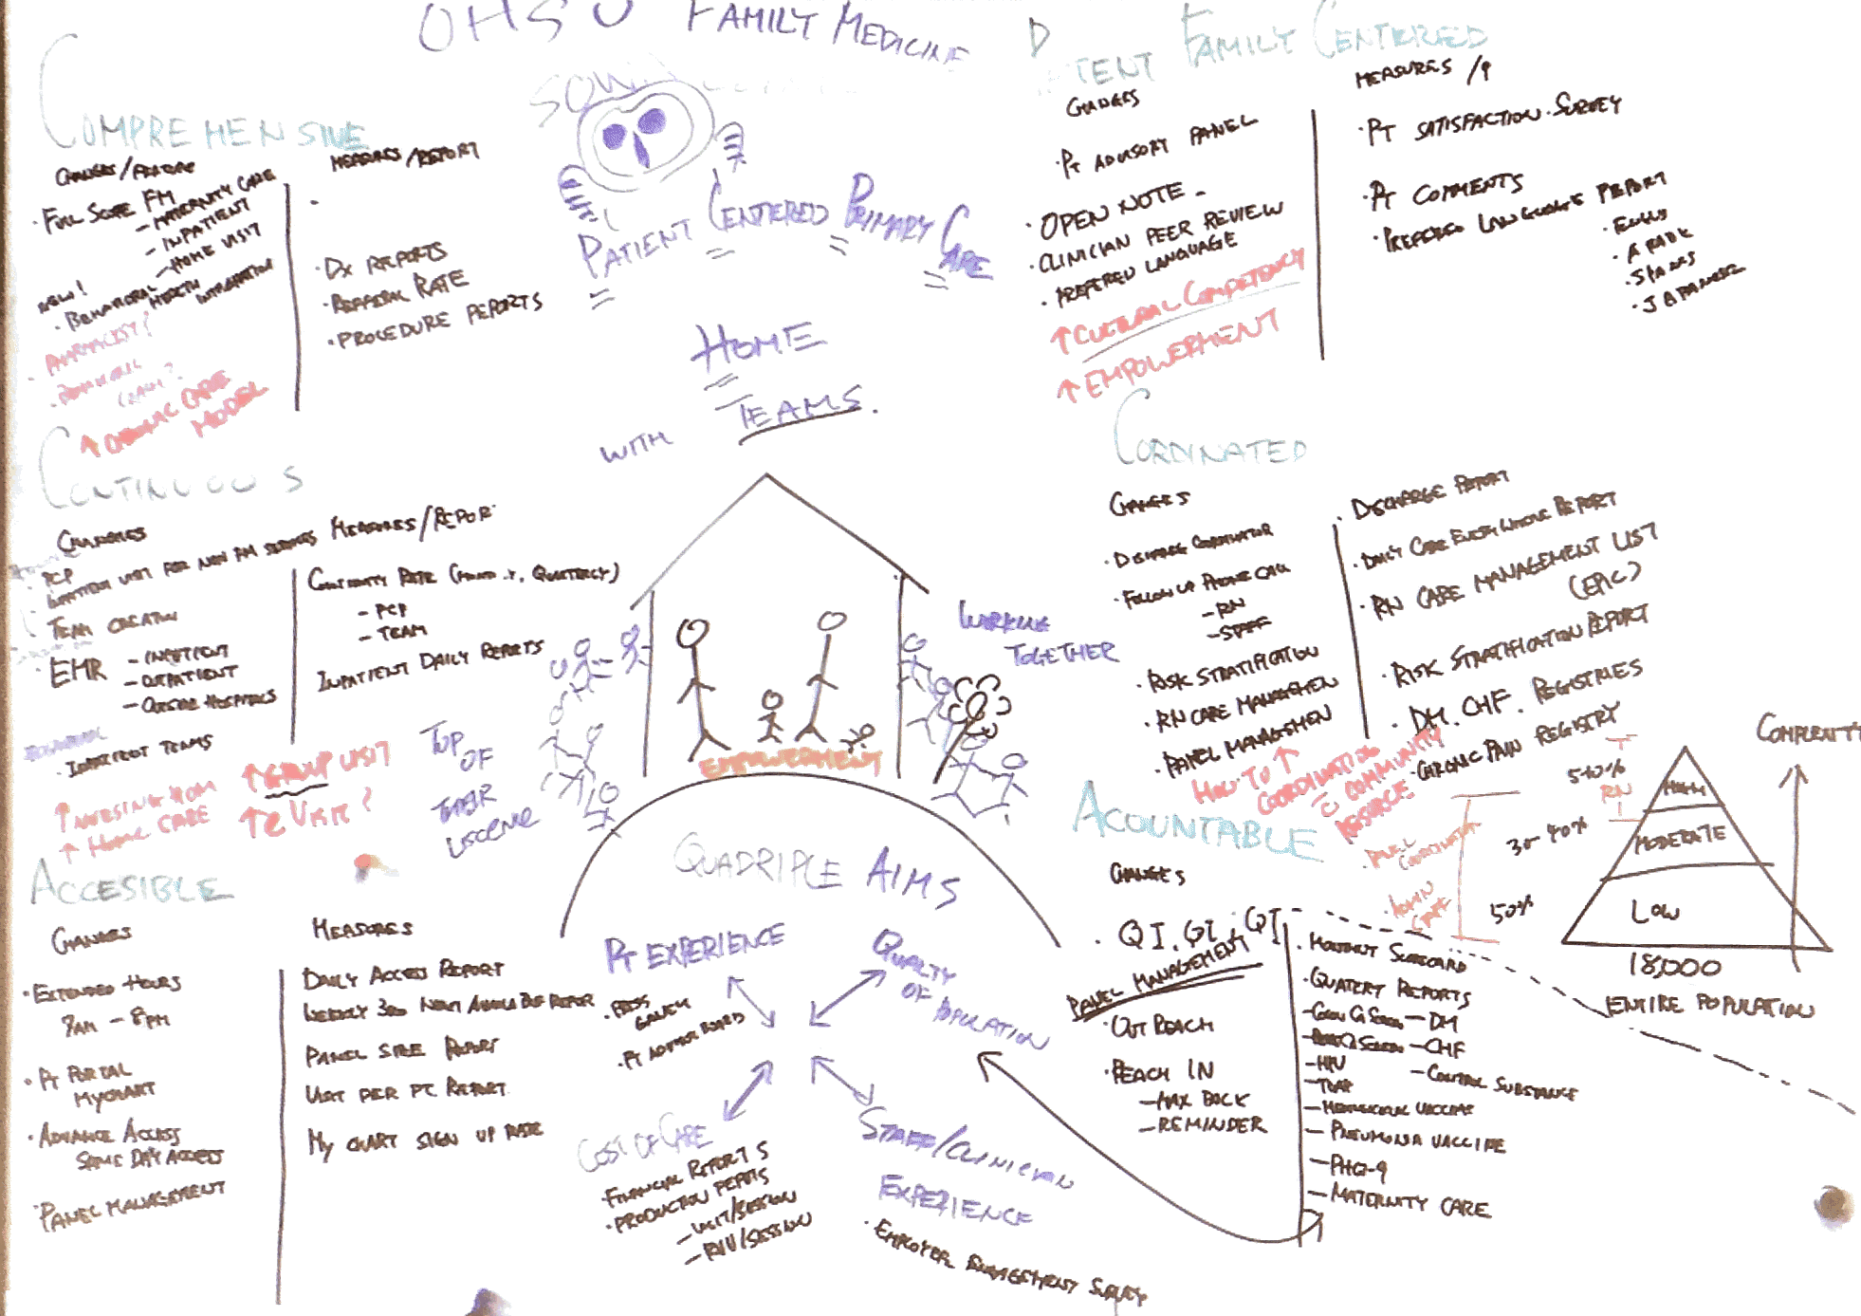

Slide 25
Patient Experience
Population Outcomes
Efficient cost
Provider Satisfaction
The PCMH Pyramid
Quadruple Aim
6 Attributes
The 10 Building Blocks
Comprehensive
Continuous
Accessible
Patient Centred
Co-ordinated
Accountable
Bodenheimers
10 Building Blocks

Slide 26
4. Building the PCMH
The 10 Building Blocks
Key Principles for change
The WHY

Slide 27
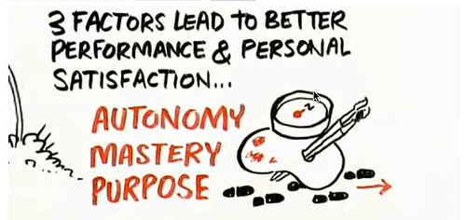
Daniel Pink; “Drive”, 2010
Notes:
“The surprising truth about what motivates us” – an essential part of the Quadruple Aim.
One of the first considerations in building a thriving practice
What makes people do what they do? For most of us (and our teams), the basic human needs of physical health have been met.
What we are building now are the higher levels of Maslows pyramid
This is more than structural design, this is Practice Culture.

Slide 28
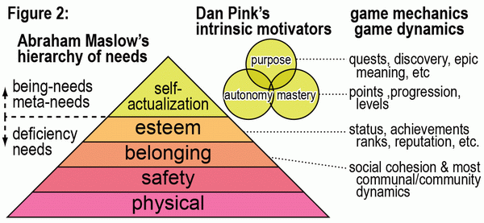
Notes:
What makes people do what they do? For most of us (and our teams), the basic human needs of physical health have been met.
What we are building now are the higher levels of Maslows pyramid
This is more than structural design, this is Practice Culture.

Slide 29
The 10 Building Blocks of High Performing Primary Care
Bodenheimer et al, Annals of Family Medicine Vol 12, No 2; Mar-Apr 2014
Notes:
One of the papers referenced in the position paper, and one of the roadmaps we used was the Bodenheimer paper.
It is worth spending a bit of time on this, because this is where we examine what we do, because pretty much all GP's I know can see themselves in these building blocks. We already have a lot of the bits of these building blocks in place. What is needed is to connect the gaps
We can evaluate the gaps between where we are and who we want to be.
THIS was the building block for our strategic plan

Slide 30
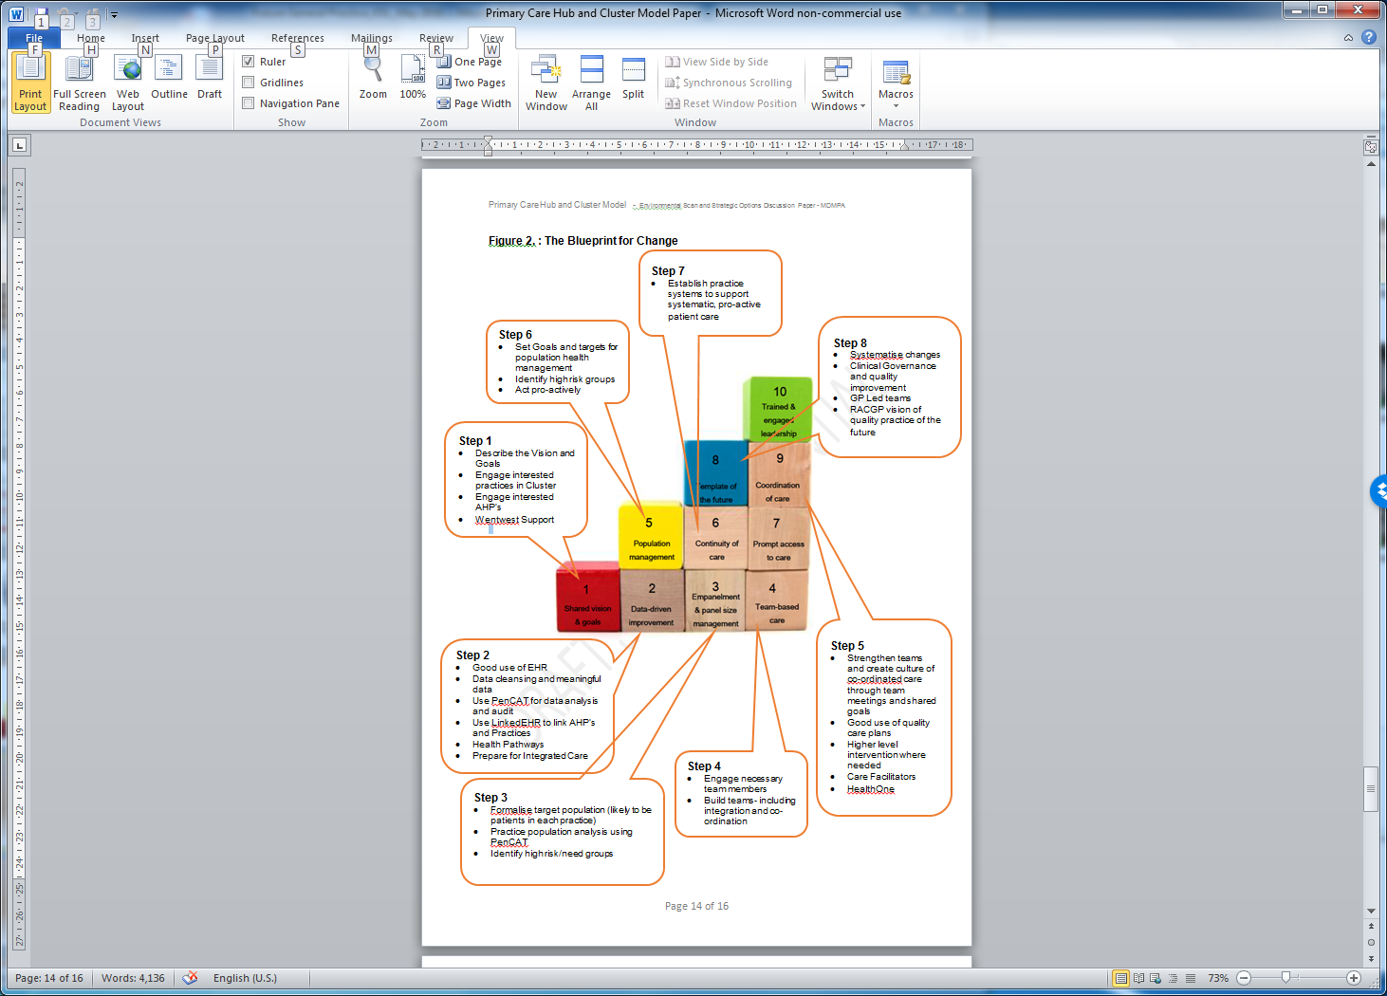
Notes:
This is our 2nd strategic plan 2 years ago.
At this stage still a very high level document

Slide 31
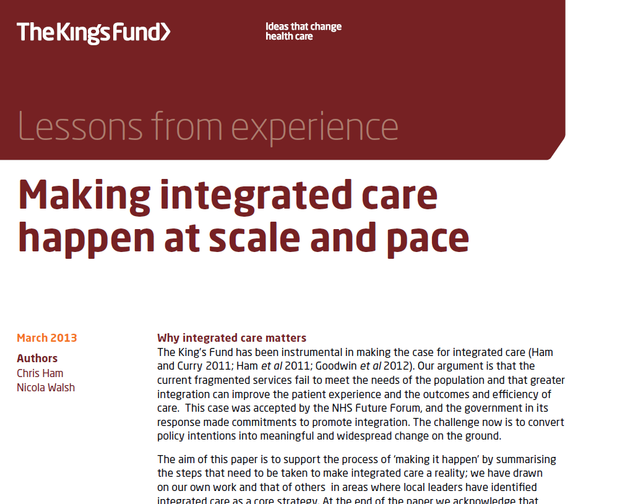
Notes:
Interestingly enough,
Integration of care can be thought of at different levels – the Macro, Meso and Micro levels.
At an individual practice level (the micro level), true integration is still important.
It is interesting that the lessons from the Kings Fund can be applied right down to the small practice level.p

Slide 32
Making Integrated Care Happen
1: Find common cause with partners and be prepared to share sovereignty
2: Develop a shared narrative to explain why integrated care matters
3: Develop a persuasive vision to describe what integrated care will achieve
4: Establish shared leadership
5: Create time and space to develop understanding and new ways of working
6: Identify services and user groups where the potential benefits from integrated care are greatest
10. Recognise there is no “best way” of integrating care
12: Share information about users with the support of appropriate information governance
13: Use the workforce effectively and be open to innovations in skillmix and staff substitution
14: Set specific objectives and measure and evaluate progress towards these objectives
15: Be realistic about the costs of integrated care
Notes:
Here are some of the important lessons we used and learned from the Kings Fund.
We share a common cause and share responsibilities
We have common goals and share the stories
We have regular meetings and discussions to review patients as well as how we do things.
We share our records and clinical information with authorized members of the team.
We identify which patient groups we need to work harder on. We start with a single issue/problem to solve – eg: our Diabetics are not as well controlled as they should be.
The cost is time and the willingness to make these changes.

Slide 33
The Building Blocks
As
Concentric Circles
Template of the Future
Population Management
Data Driven Improvement
Team Based Care
Access to Care
Engaged Leadership
Continuity of Care
Patient Team Partnership
Empanelment
Comprehensiveness and Care Co-ordination

Slide 34
5. The Evidence for PCMH

Slide 35
TODAY’S CARE
PCMH CARE
My patients are those who make appointments to see me
Our patients are the population community
Care is determined by today’s problem and time available today
Care is determined by a proactive plan to meet patient needs with or without visits
Care varies by scheduled time and memory or skill of the doctor
Care is standardized according to evidence-based guidelines
I know I deliver high quality care because I’m well trained
We measure our quality and make rapid changes to improve it
Patients are responsible for coordinating their own care
A prepared team of professionals coordinates all patients’ care
It’s up to the patient to tell us what happened to them
We track tests & consultations, and follow-up after ED & hospital
Clinic operations center on meeting the doctor’s needs
A multidisciplinary team works at the top of our licenses to serve patients
Slide from Daniel Duffy MD School of Community Medicine Tulsa Oklahoma

Slide 36



Slide 37
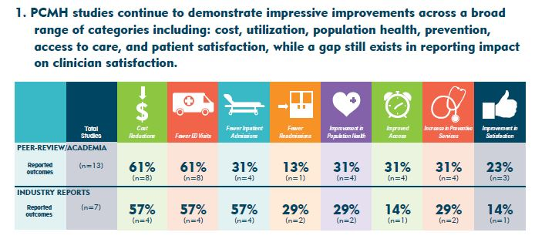

Slide 39
Implementation of Oregon’s PCPCH Program: Exemplary Practice and Program Findings
Executive Summary, September 2016
Reduced total service expenditures per person by 4.2% or approximately $41 per person per quarter (~$13.50/month).
Effects increased significantly the longer clinics were designated as a PCPCH, generally doubling from the first to third year of recognition.
Resulted in $13 in savings in other services, such as specialty care, emergency department and inpatient care, for every $1 increase in primary care expenditures related to the PCPCH program.

Slide 40
6. Practice Improvements and Outcomes
Our Practice…

Slide 41
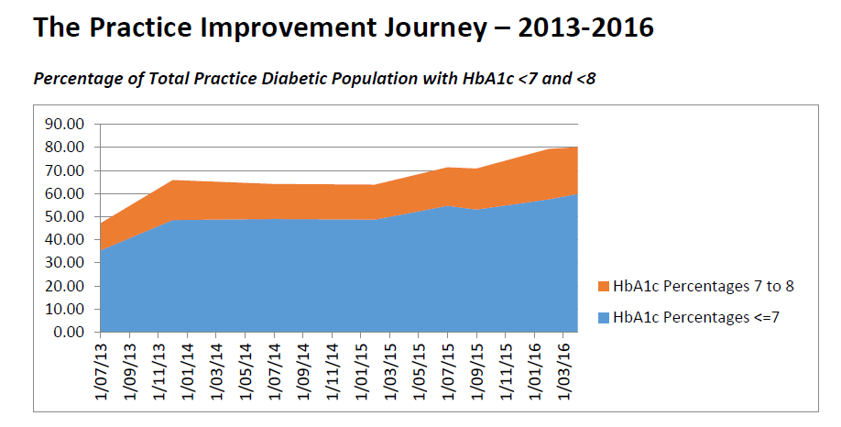
Percentage of Total Practice Diabetic Population with HbA1c <7 and <8
Notes:
This is what we did. Data is a DRIVER. Seeing the improvement lifts the staff.
We all have a complex relationship with data. Through our training and instinctively we know the power of data.
BUT – Data is scary! – especially when we are looking at our own data.
That’s a little like going through Kubler Ross’s stages of grief
Denial
Bargaining
Depression
Acceptance

Slide 42
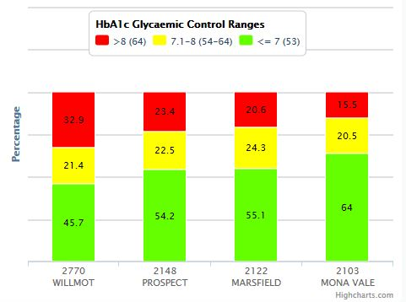
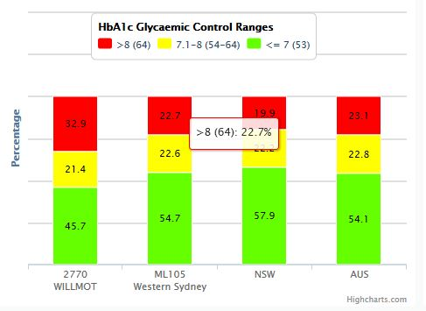
Glycaemic Control by Postcode – 2012 Data

Slide 43
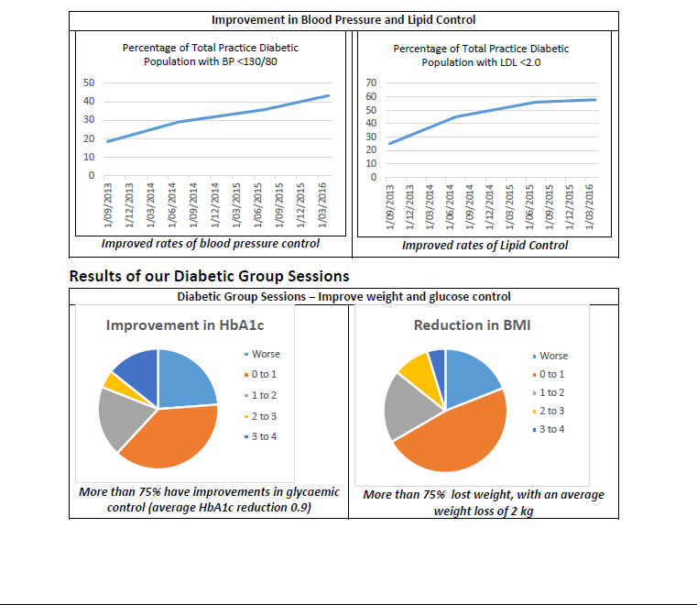
Notes:
Here are some other graphs
Improved outcomes make providers feel better! It makes whole team feel better!
It answers the question “ This is why we do what we do”
Our mistake – trying to do too much. Start with small things.

Slide 44

Co-ordinated, comprehensive multidisciplinary, integrated team based care
Notes:
We aren’t there yet, and the reality is that we will never be there, but we as a team finally feel we have earned the badge we set out to achieve.
This is the subtlety of the Medical Home – it is not just a home for patients, but also for providers and the whole practice team!
Autonomy, Mastery and Purpose leading to engagement and team satisfaction

Slide 45
7. Summary and Questions
Meeting the Quadruple Aim
Assessing Performance on the 10 Building Blocks
RACGP Standards for the PCMH

Slide 46


Slide 47
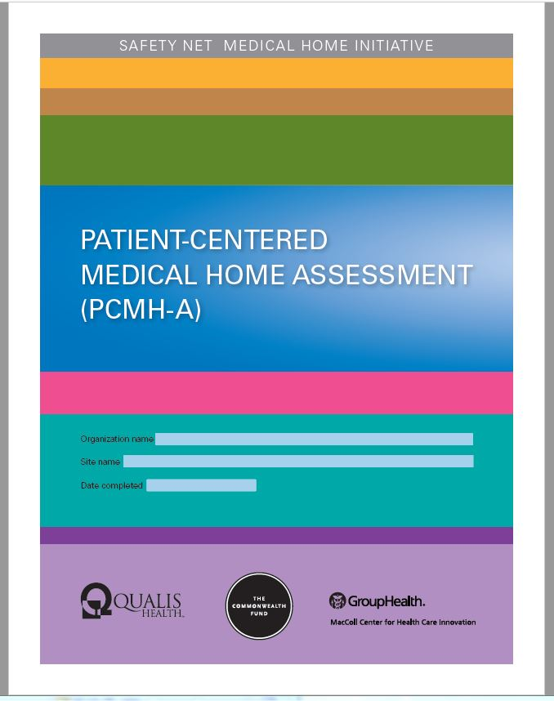

Slide 48
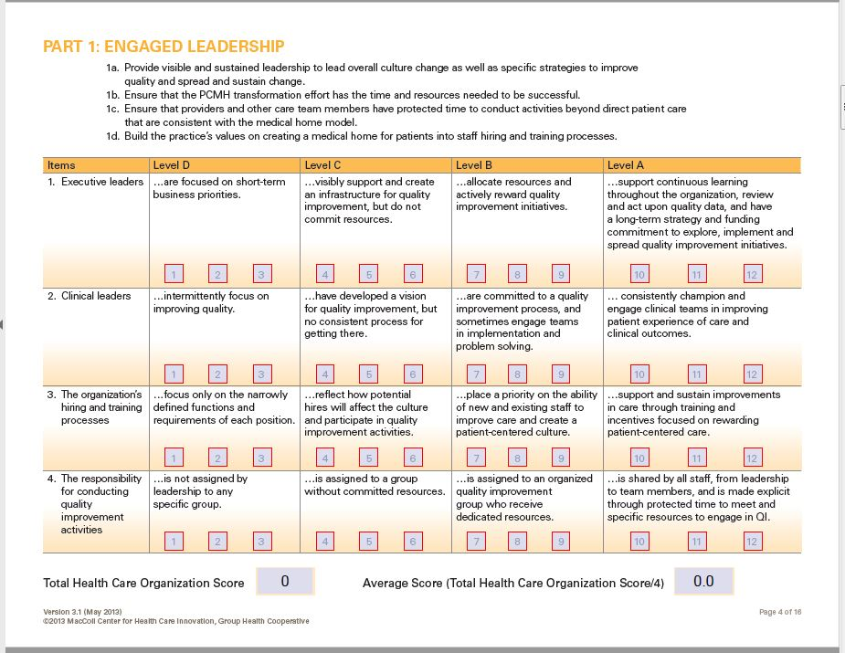

Slide 49
Quadruple Aim
Improving patient experience
Improving population health
Efficient cost
Provider Satisfaction

Slide 50
Thank you and
Questions

