Slide 1

Picking the anabolic steroid user in your waiting room: Why it is important to manage and reduce harm
Dr. Beng Eu
Dr. Kevin Lee

Slide 2
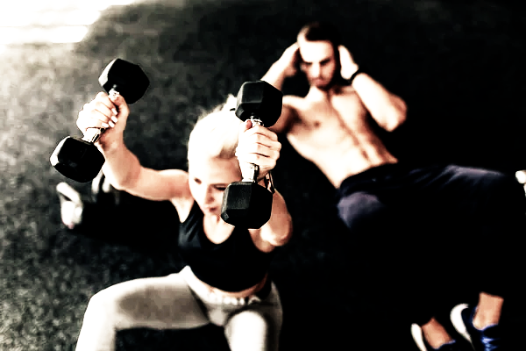
Agenda
Poll
Case 1 – Beng Eu followed by Discussion
Case 2 – Kevin Lee followed by Discussion
General Q + A
Poll

Slide 3
Poll 1
How common is PIEDs use in Australia?
< 1% 1 – 2% > 2%
Do you think you see anyone who uses PIEDs?
Yes No Unsure
How comfortable are you managing patients using PIEDs?
I am comfortable treating patients who are using PIEDs
I am not sure how to manage patients using PIEDs
I don’t have patients in my practice using PIEDs
I think I have patients using PIEDs, but am not sure how to ask if they are using PIEDs

Slide 4
Learning Objectives
Increase awareness of this practice and the population affected
Understand how to use harm minimization in this group
How to get relevant information to assist in management
How to practice safely

Slide 5
Case 1
Cole, 32 yo male, Ht 182.5 cm, BMI 26.1
Past hx depression- seeing psychologist, not on Rx
Has been a patient of the clinic for 10 years, no other significant health issues
Presents with R gluteal abscess.
On questioning, admitted to using androgenic-androgenic steroids for the last few months. Self-injecting into gluteal muscle. Using testosterone + trenbolone 3 times a week.
What is important about his presentation?

Slide 6

Performance and image enhancing Drugs- PIEDs
AAS (Anabolic-androgenic steroids)
Testosterone
Nandrolone (deca)
Boldenone (eq, equipoise)
Stanazolol
Methenolone
Trenbolone (tren)
80-90% of all PIEDs
Hormones
HGH
HGH-like
SARMs
IGF-1
Peptides
Insulin
Post-cycle therapy
Clomiphene
Tamoxifen
Anastrozole
HCG

Slide 8
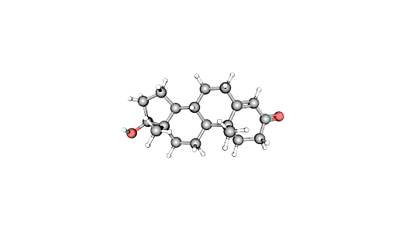
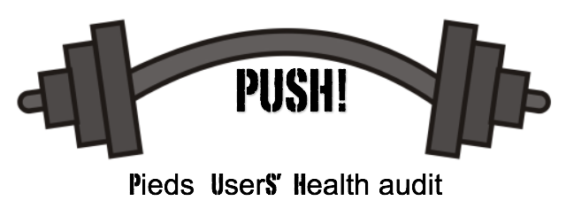
AUDIT period– May 2019-May 2021 (RACGP NREEC 18-12)
6 collaborating sites (+3) in 5 cities
Data collected by doctors-redcap or excel
Target populations- prescribed testosterone and non-prescribed PIEDs (including testosterone) – testosterone deficient, transgender and non-prescribed use
Demographics, blood test results, reported AEs

Slide 9
How is PIEDs used?
Mostly IM injections, gluts >thigh
Some oral (especially PCT)
Insulin- s/c
In cycles 3/12 on and off
Blast and cruise
Continuous
Stacking

Slide 10
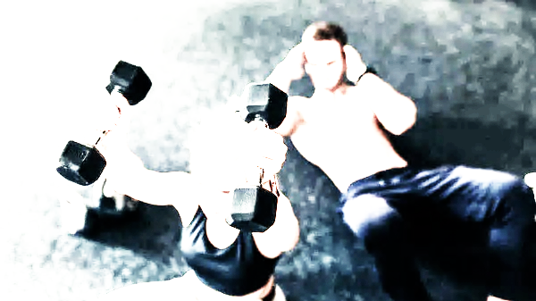
What and How are PIEDs used? – PUSH!
Route of administration:
  IM: 93% (n=160)
  Oral: 16% (n=28)
  Topical: 1.3% (n=2)
  SCI: 0.6% (n=1)

Slide 11
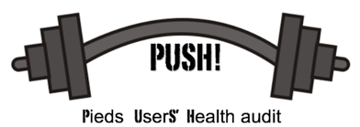
PUSH! Demographics
Mean age: 38.1 years
  <25 : 3.2% (n=5)
  25-34: 32.3% (n=51)
  35-44 : 39.2% (n=62)
  45+ : 25.4% (n=40)

Slide 12
PUSH! Demographics
Body Mass Index (BMI)*
  <18.5: 0% (underweight)
  18.5-24.9: 12.7% (n=20) (healthy)
  25-29.9: 55.7% (n=88) (overweight)
  Over 30: 31.7% (n=50) (obese)
Mean – 28.0
Australian Average BMI – 28.1

Slide 13
PUSH! AUDIT - Motivations for use
  Body image: 87% (n=150)
  Body building: 33% (n=57)
  Test. Deficiency: 9% (n=15)
  Sporting: 3% (n=5)
  Work: 1% (n=2)

Slide 14
What and How are PIEDs used? – PUSH!
Anabolic/Androgenic Steroids AAS) used:
  Testosterone: 92% (n=158)
  Nandrolone: 17% (n=30)
  Trenbolone: 15% (n=25)
  Boldenone: 9% (n=15)
  *Oxandrolone: 6% (n=11)
Masteron. 5%(n=8)
*Dianabol. 5%(n=8)
Other PIEDs of note:
  HGH: 7% (n=12)
  SARM: 3% (n=5)
  Peptides: 0.5% (n=1)
  Insulin: 0%
  * oral agents

Slide 15
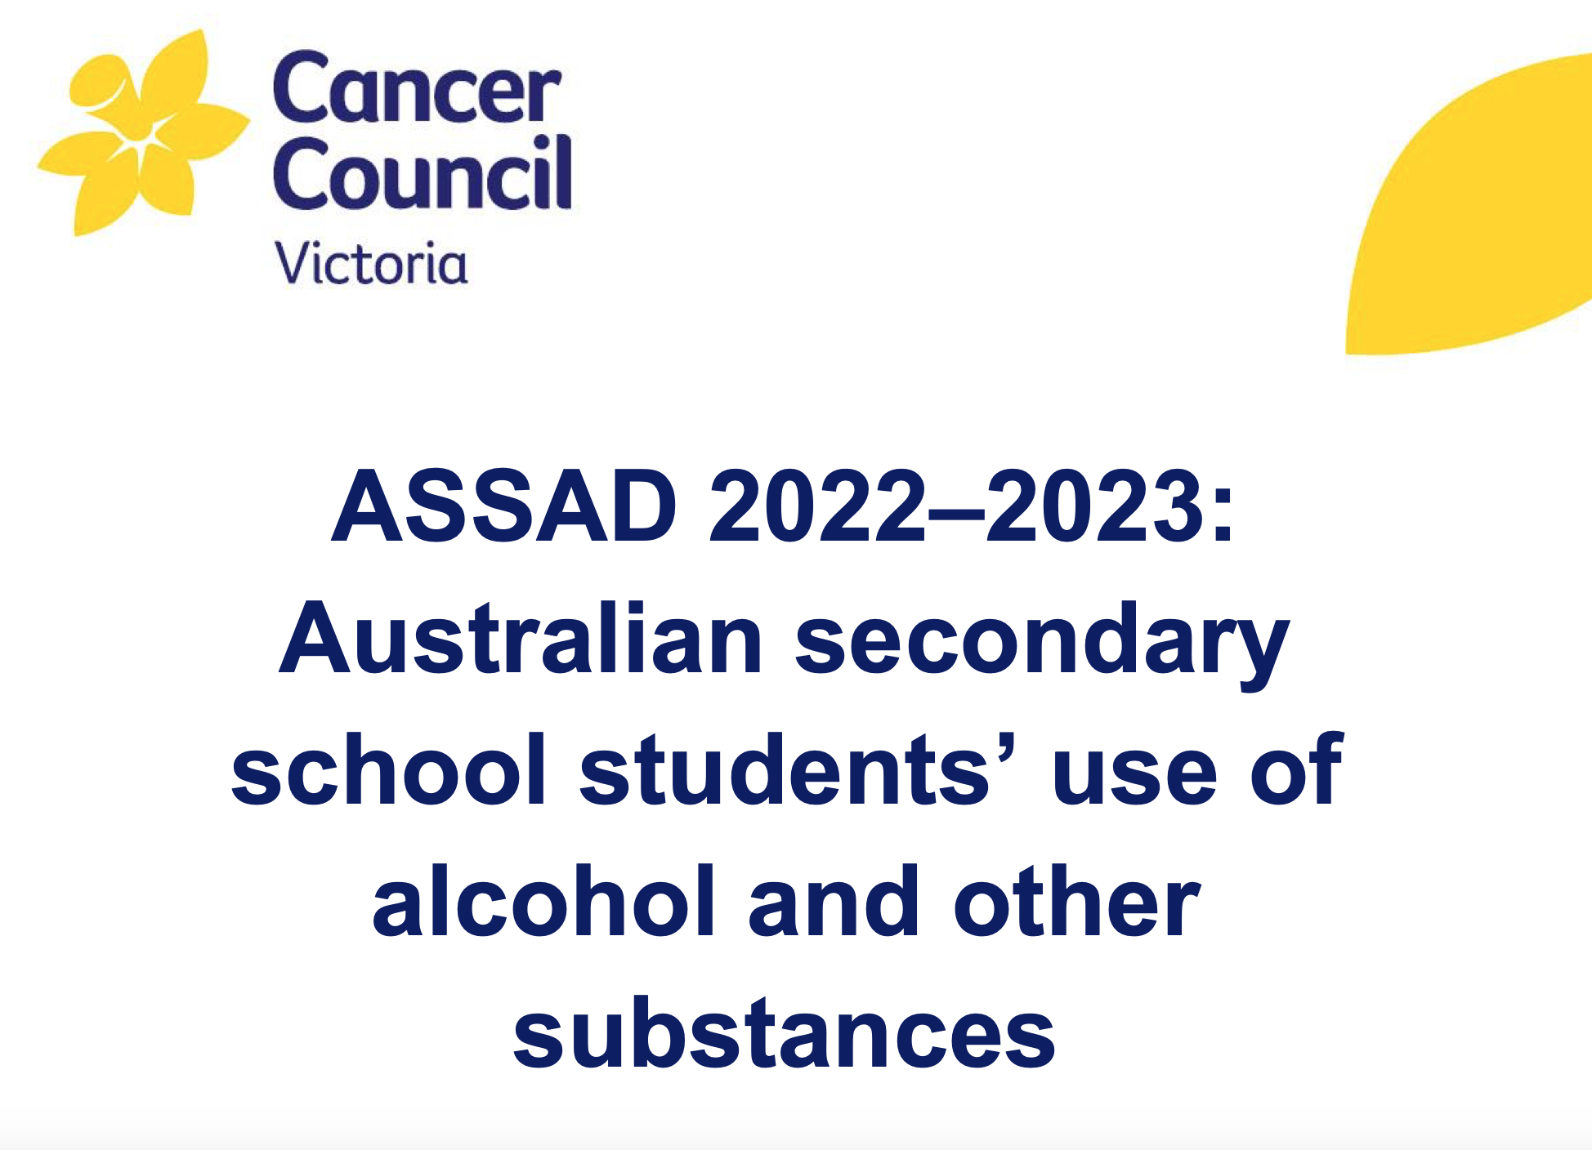
How prevalent is AAS use in Australia?

Slide 16
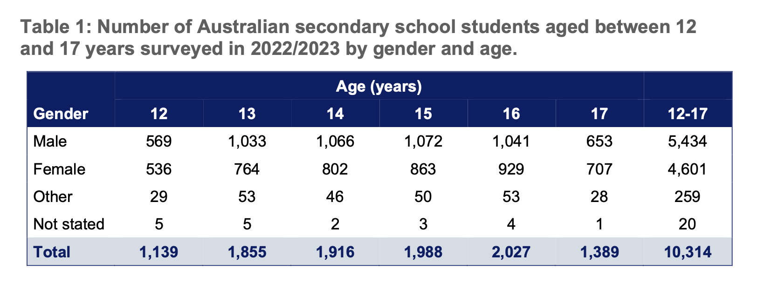

Slide 17
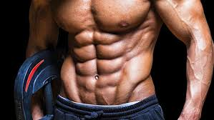
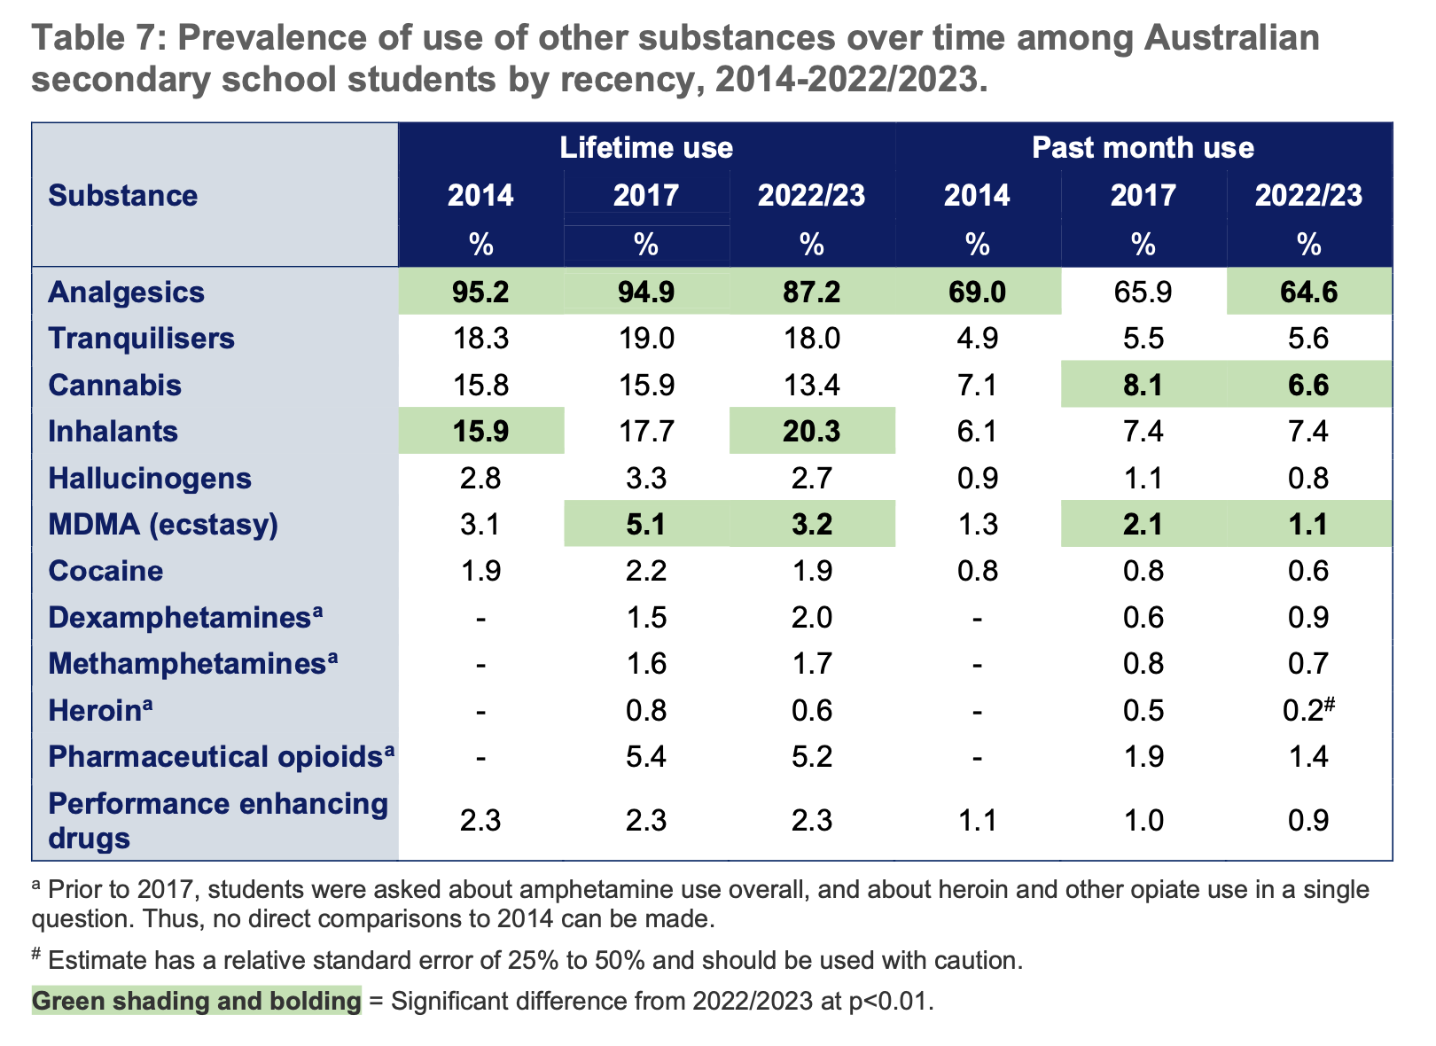
(anabolic steroids)

Slide 18
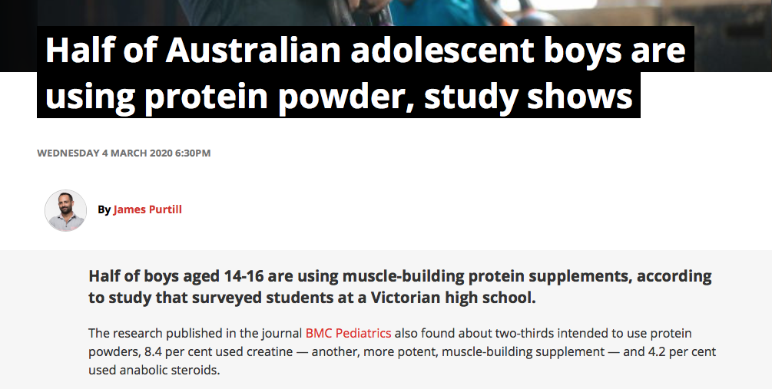

Slide 19
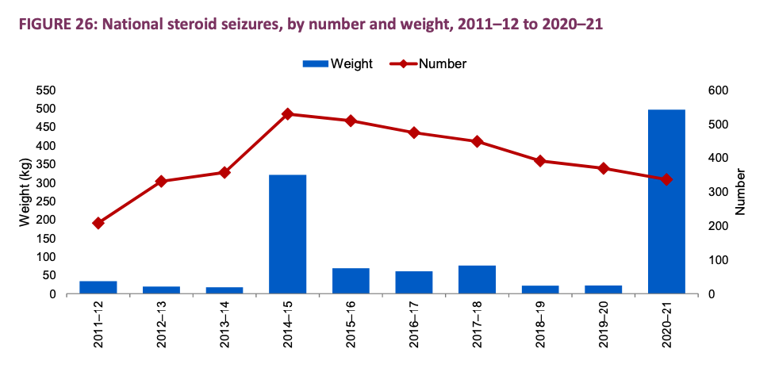
Australian Criminal Intelligence Commission - Illicit Drug Data Report 2020-2021

Slide 20
A recent purposive survey of 94 steroid and image enhancing drug users in the UK found that only 6% reported seeking medical assistance when they experienced adverse effects related to AAS use. Users cited lack of understanding from their doctor as one of the reasons they did not engage with health services (Chandler & McVeigh, 2013).
Similarly, a recent convenience study of injecting AAS users revealed only a minority (17%) of AAS injectors who experienced redness, swelling, or tenderness around the injection site had ever sought treatment (Hope et al., 2015).

Slide 21
Case 1
Cole, 32 yo male, Ht 182.5 cm, BMI 26.1
Past hx depression- seeing psychologist, not on Rx
Has been a patient of the clinic for 10 years, no other significant health issues
Presents with R gluteal abscess.
On questioning, admitted to using androgenic-androgenic steroids for the last few months. Self-injecting into gluteal muscle. Using testosterone + trenbolone 3 times a week.
What is important about his presentation?

Slide 22
Cole (continued)
Abscess treated and resolved. He was very embarrassed about it.
Discussed safe injecting technique, potential adverse effects
Blood tests done- FBE,LFTs normal
Cole said that he would stop using AAS.

Slide 23
Cole (continued)
Presented 4 months later
R gluteal abscess again – low gluteal- re-educated about injection site
Blood tests ordered- elevated ALT (<2x ULN), normal FBE
He was on a AAS cycle currently, so was planning a break in his cycle- wondering about using PCT?
(Over the next 2 months , presented with severe back acne, snoring and chest injury from the gym)

Slide 24
The impact of harm reduction practice on non-prescribed Performance and Image Enhancing Drugs (PIEDs) use

Slide 25

The impact of harm reduction practice on non-prescribed Performance and Image Enhancing Drugs (PIEDs) use -Conclusions
77% said there was benefit
65-72%- better monitoring/treatment
47% reduction
12% ceased
Engagement with GP resulted in significant change

Slide 26
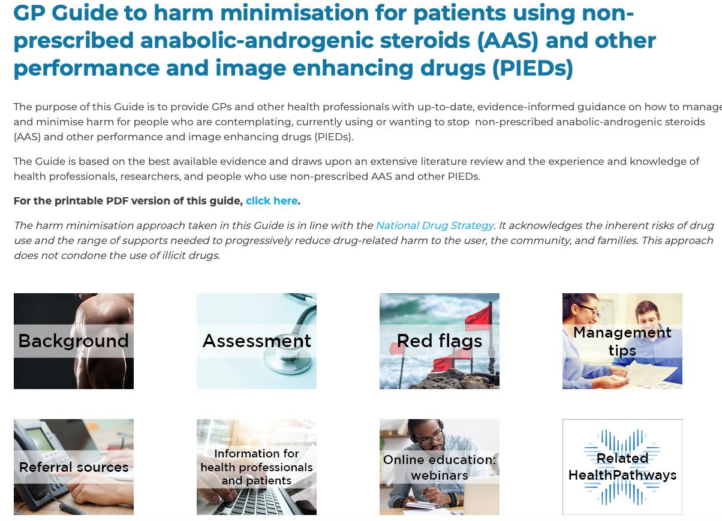

Slide 27
Harm reduction for people using PIEDs
Offer to monitor not prescribe (unless for treatment) - some medications requested may be restricted in certain states.
Ensure good overall advice provided- eg. Injection site, multi-dose vials.
Encourage cessation or reduce use to reduce harm
Refer for further opinion if appropriate (eg. Endocrinologist, cardiologist)
Engage in them in health care
Provide info/education about potential harm
Monitor for AEs blood tests, echo, mental health
Provide info about less harmful options, using less

Slide 28
PCT Post-cycle Therapy
The use of agents to attempt to stimulate natural testosterone after using AAS or reduce potential adverse effects
Common agents- tamoxifen, clomiphene, HCG, cyclofenil, anastrozole, (SARMS)
Often used after a cycle but sometime used during the cycle
Complex dosing schedules online
May include anti-hypertensives, cabergoline

Slide 29
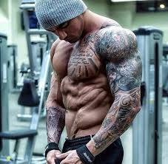
Appearance
Acne
Balding
Gynaecomastia
Testicular shrinkage
Neuro endocrine system
Testicular pain
Suppression of HPG axis-Cognitive defects
Ongoing testosterone suppression
Infertility

Slide 30
CVS/metabolic effects
Polycythemia
Hypertension
Hyperlipidaemia ( Chol + TG)
Increased HBA1c
Cardiomyopathy
Myocardial Infarction, CVA, Conduction Abnormalities
Cardiac Death
Other adverse effects
Injecting site reactions
Liver toxicity (oral > IM)
Injecting risks- BBV, haematoma, abscesses
Muscle, joint pains, CK increase
Pulmonary micro-embolism

Slide 31
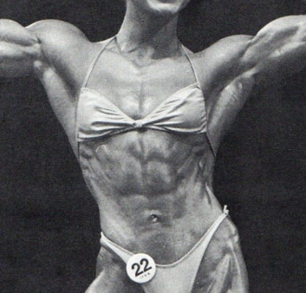
Mental Health
Depression (during and after)
Emotional disorder
Insomnia
Restlessness
Aggression
Irritability
Withdrawal effects
Additional AES in women
Clitoral growth
Deepening of voice
Loss of breast tissue
Disruption of menstrual cycles

Slide 32
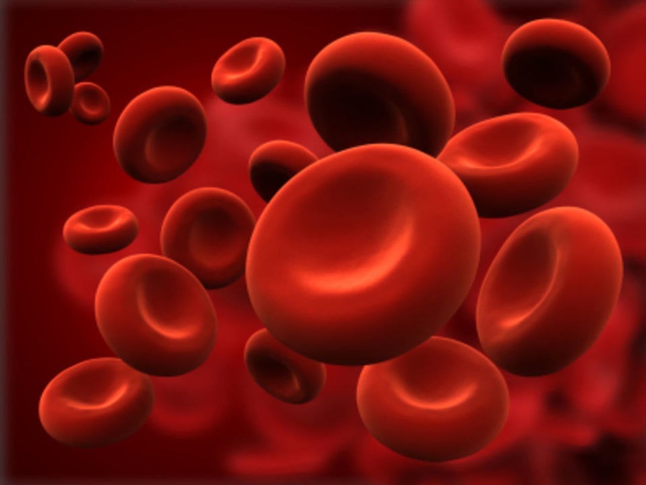
Polycythemia (Hb > 18g/dL)
Clinical relevance?
 |  | Non prescribed |  | Prescribed | chi²
 | n | (n/n)% | n | (n/n)% | p value | Expected value %
Hb > 18 | 94 | (9/94) 9.6 | 167 | (13/167)7.8 | 0.25 | 2.5 PR^ 3.8
^PR – Prevalence ratio
*Hb higher in non-prescribed group with no increase in polycythemia
**Both groups have significantly higher polycythemia rates than population average

Slide 33
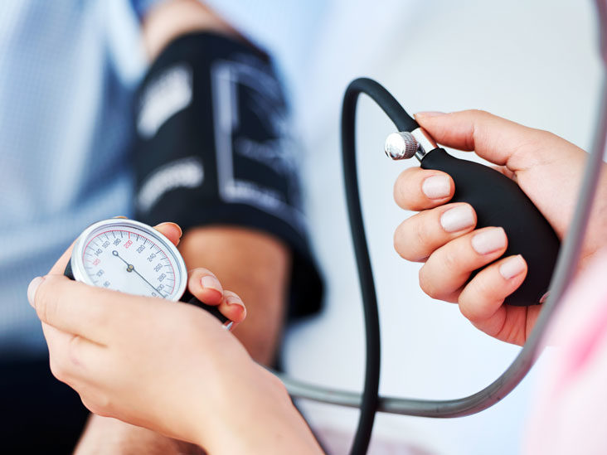
Hypertension
Clinical relevance?
*ABS ( Australian Bureau of Statistics) definition – either systolic >140 or diastolic > 90
 |  | Non-prescribed |  | Prescribed | chi2
 | n | % | n | % | p value
Hypertension | 95 | 38.9^ | 219 | 25.1 | 0.01
^Compared to ABS data for 35-44 yo men- 18%, PR 2.1
*2 in non-prescribed group had controlled hypertension (including them would mean 41% had HT) 102 in prescribed group had controlled hypertension. (total (uncontrolled + controlled) =46.6%)
**Most HT was uncontrolled in non-prescribed group

Slide 34
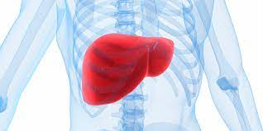
Liver toxicities
Doctors were first asked if there were abnormal LFTs results and only if there were, then the values were entered.
 |  | Non-prescribed |  | Prescribed | Chi²
 | n | % | n | % | p value
Abnormal LFTs | 97 | (53/97) 54.6% | 205 | (55/205) 27.0% | <0.0001

Slide 35
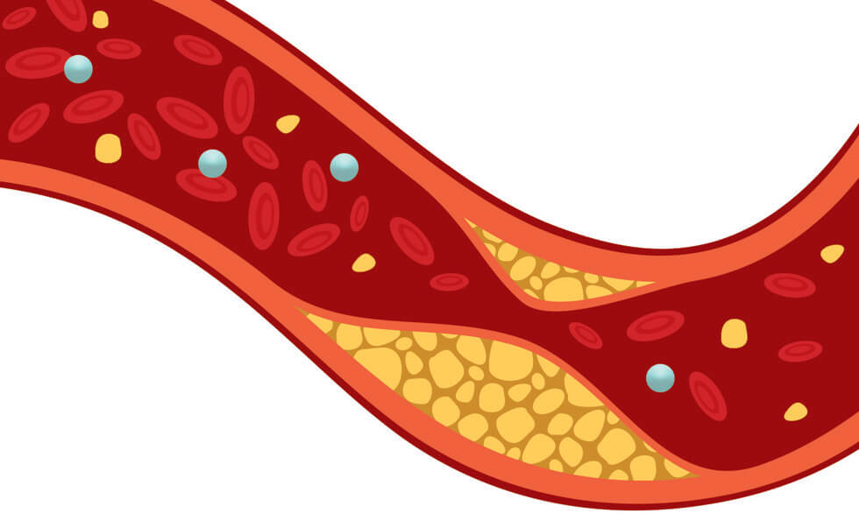
Hyperlipidaemia
Clinical relevance
 |  | Non- prescribed |  | Prescribed | chi² | ABS value | Compared to ABS
 | n | % | n | % | p value
Total Chol. >5.5 | 74 | (17/74) 23% | 167 | (51/167) 30.5% | ns | 7% | PR 3.3
*none in non-prescribed group on lipid lowering medication, 38 in prescribed group had controlled hyperlipidemia (total 31.8% with hyperlipidemia)
** all hyperlipidemia was uncontrolled in non-prescribed group

Slide 36
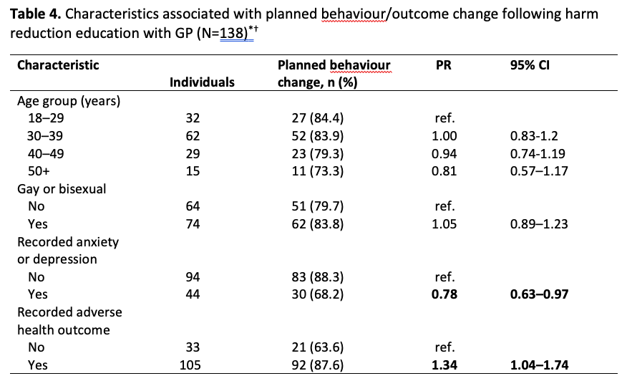

Slide 37
Cole (continued)
Presented 6 months later
  Over the last 6 months , had presented with severe back acne, snoring and chest injury from the gym
Said he had ceased using AAS
Blood tests ordered- normal LFTs, Lipids, normal FBE
Was reporting a low sex drive and fatigue
Testing showed a low testosterone level- 8.3 (7.1 when repeated)
Referred to endocrinologist and is on TRT currently

Slide 38
Cole (continued)
Presented 6 months later
  Over the last 6 months , had presented with severe back acne, snoring and chest injury from the gym
Said he had ceased using AAS
Blood tests ordered- normal LFTs, Lipids, normal FBE
Was reporting a low sex drive and fatigue
Testing showed a low testosterone level- 8.3 (7.1 when repeated)
Referred to endocrinologist and is on TRT currently

Slide 39
Case Study 1- references
Australian Journal of General Practice
Volume 52, Issue 4, April 2023
Impact of harm reduction practice on the use of non-prescribed performance and image-enhancing drugs: The PUSH! Audit
Beng Eu Joshua Dawe Matthew Dunn Kevin Lee Scott Griffiths Mark Bloch David Baker Clara Tuck Meng Soo Fiona Bisshop Mark Stoové
Drug and Alcohol Review Journal
The health effects of non-prescribed anabolic–androgenic steroid use: Findings from The Performance and image-enhancing drugs UseRS' Health (PUSH) audit
Matthew Dunn, Joshua Dawe, Beng Eu, Kevin Lee, Timothy Piatkowski, Mark Stoové

Slide 40
Case Study 1
Questions and discussion

Slide 41
Case Study 2
Mr AJ, 29 y.o male presenting to LMO for fatigue, low mood, poor sleep and low libido.
Felt uncharacteristically irritable.
Affecting work as security guard.
Did not disclose AAS use but secondary workup revealed a total testosterone or 3.5nmol/L (10-35).

Slide 42
Case Study 2 cont’d
On specific questioning, he admitted to using multiple anabolic agents and ceased 9 months ago.
Started using AAS since age 17 including stanozolol, nandrolone, oxandrolone and methandienone obtained over the counter in native country.
Post cycle HCG was used previously

Slide 43
Case Study 2 cont’d
Discussed his motivation using PIED and risks vs benefit.
Suggested regaining own HPT axis function.
Trial HCG 1500u three times a week
1 month later, T 26nmol/L.
Marked improvement in mood and irritability
Expressed concerns about fertility and review of semen showed good functionality.

Slide 44
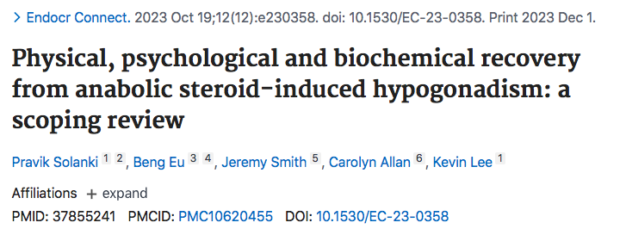

Slide 45
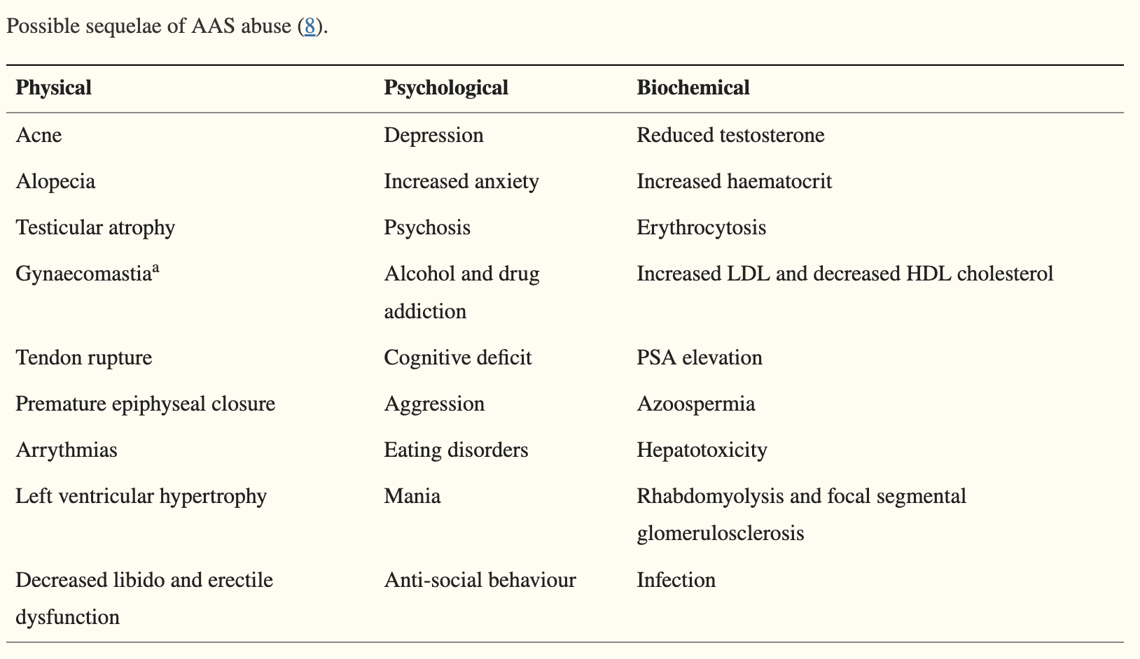

Slide 46
Case Study 2 cont’d
HCG used for three months to restore testicular function.
LH 3 IU/L (1-10), T 14nmol/L at end of treatment.
Feels some return of symptoms in terms of lack of libido and ED
Trial Sustanon 250mg IM every 3 weeks

Slide 47
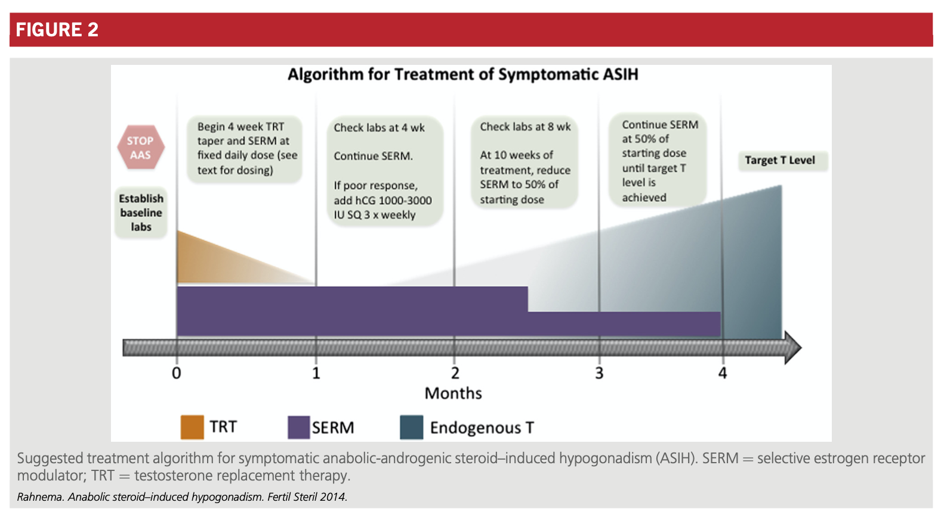

Slide 48
Case Study 2 cont’d
Concern regarding using it more frequently on his own accord
Repeat testing showed T 49 nmol/L (10-30), SHBG 15nmol/L (17-56), free testosterone 1959 pmol/L (260-740), oestradiol 225pmol/L (<160).
Explained he has not followed prescribed suggestion and risk involved.
Mr AJ admitted to reducing to using every 5 days.
A script was given for sustanon with no repeats and path form given to check trough at the end of returning to three 3 week cycles.

Slide 49
Case Study 2 cont’d
He did not return for follow up on scheduled 2.5 month review date.
However, 18 month later, he returned and had similar symptoms.
Discussed his motivation with PIED use and intentions moving forward.
Currently using primoteston 0.5mL every week (125mg).
T 17.5nmol/L, PCV 0.5, PSA 0.8 ug/L (0.25-2.1), normal LFTs.

Slide 50
Is AAS use an addiction?
American Psychiatric Association – Addiction is severe substance use disorder
According to the National Institute on Drug Abuse, people begin taking drugs for a variety of reasons, including:
to feel good — feeling of pleasure, “high”
to feel better — e.g., relieve stress
to do better — improve performance
curiosity and peer pressure

Slide 51
Is AAS use an addiction?
Symptoms of substance use disorder are grouped into four categories:
Impaired control: a craving or strong urge to use the substance; desire or failed attempts to cut down or control substance use
Social problems: substance use causes failure to complete major tasks at work, school or home; social, work or leisure activities are given up or cut back because of substance use
Risky use: substance is used in risky settings; continued use despite known problems
Drug effects: tolerance (need for larger amounts to get the same effect); withdrawal symptoms (different for each substance)
YES, it can be

Slide 52
Mental Health aspects of PIEDs use
Predisposing issues:
Self-esteem
Body Dysmorphia
Anxiety
Depression
Personality Disorders

Slide 53
Mental Health aspects of PIEDs use
During PIEDs use:
Aggression
Agitation
Depression
Anxiety
Mania
Psychosis
(May be dose and substance dependent)

Slide 54
Withdrawals from AAS
Symptoms from withdrawal from anabolic steroids include:
Mood swings.
Serious depression.
Fatigue and excessive sleeping.
Restlessness.
Loss of appetite.
Trouble sleeping or insomnia.
Decreased sex drive.
Cravings for steroids.

Slide 55
AAS cycles
Predisposing mental state
Body dysmorphia
Self-esteem
Depression, anxiety,etc
Withdrawals
Depression
Fatigue
Restlessness
Low libido, etc.
AEs from AAS
Aggression
Agitation
Anxiety, etc

Slide 56
Treatment for AAS use
Therapy- limited
No programs, no self-help
Medications- none for at least 6-12 months
Harm reduction is the only modality used

Slide 57
Summary
Be aware that anabolic steroid misuse is happening and sequelae can be managed if:
  You monitor and are proactive with these sequelae
  Have an open, honest, non-judgemental discussion of your care.
  Reassure your patient their safety is your priority
  Harm reduction practice shown to be beneficial
Referral and shared care is best involving:
  Endocrinologists
  Psychologists
  Nurses

Slide 58
Case Study 2
Questions and discussion

Slide 59
Poll 2
Do you think you see anyone who uses PIEDs?
Yes No Unsure
How comfortable are you managing patients using PIEDs?
I am comfortable treating patients who are using PIEDs
I am not sure how to manage patients using PIEDs
I don’t have patients in my practice using PIEDs
I think I have patients using PIEDs, but am not sure how to ask if they are using PIEDs

Slide 60
General discussion
Next steps? Special Interest Group?
kevin.lee@monash.edu
beng@prahranmarketclinic.com

